Slide 1

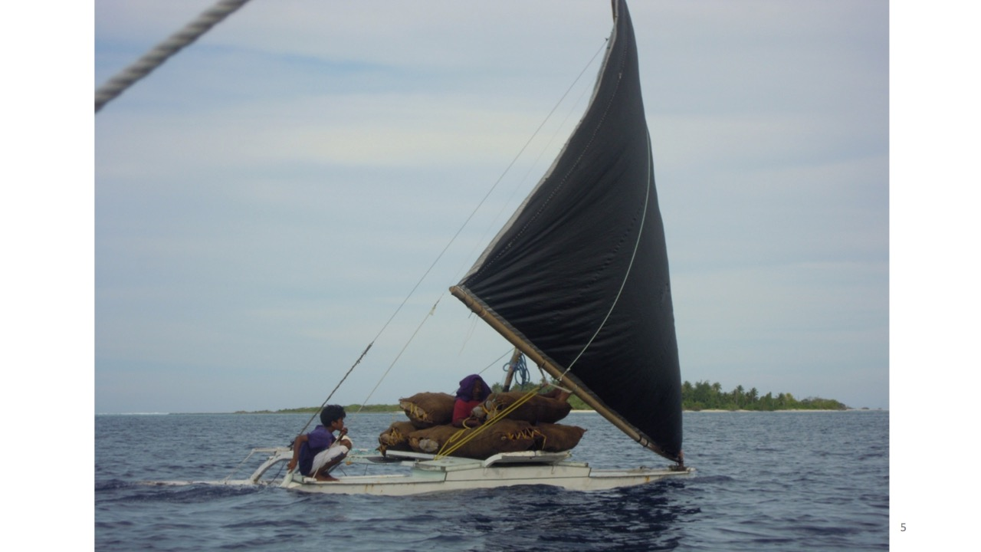
Micronesian Center for Sustainable Transport
What is THE 1.5 tax for Shipping?
Notes:
In this presentation I will:
Outline the work programme that we have been developing through USP since 2012.
Make the case that the Pacific needs to transition to a low carbon
Discuss the need for a centre of excellence and a regional programme based on education and research
Why RMI
Barriers to transition

Slide 2
The MCST Board have asked us to answer 3 questions?
What is THE 1.5 tax for Shipping? = today’s talanoa
What would we have to trade with who to get it?
Who will decide?

Slide 3
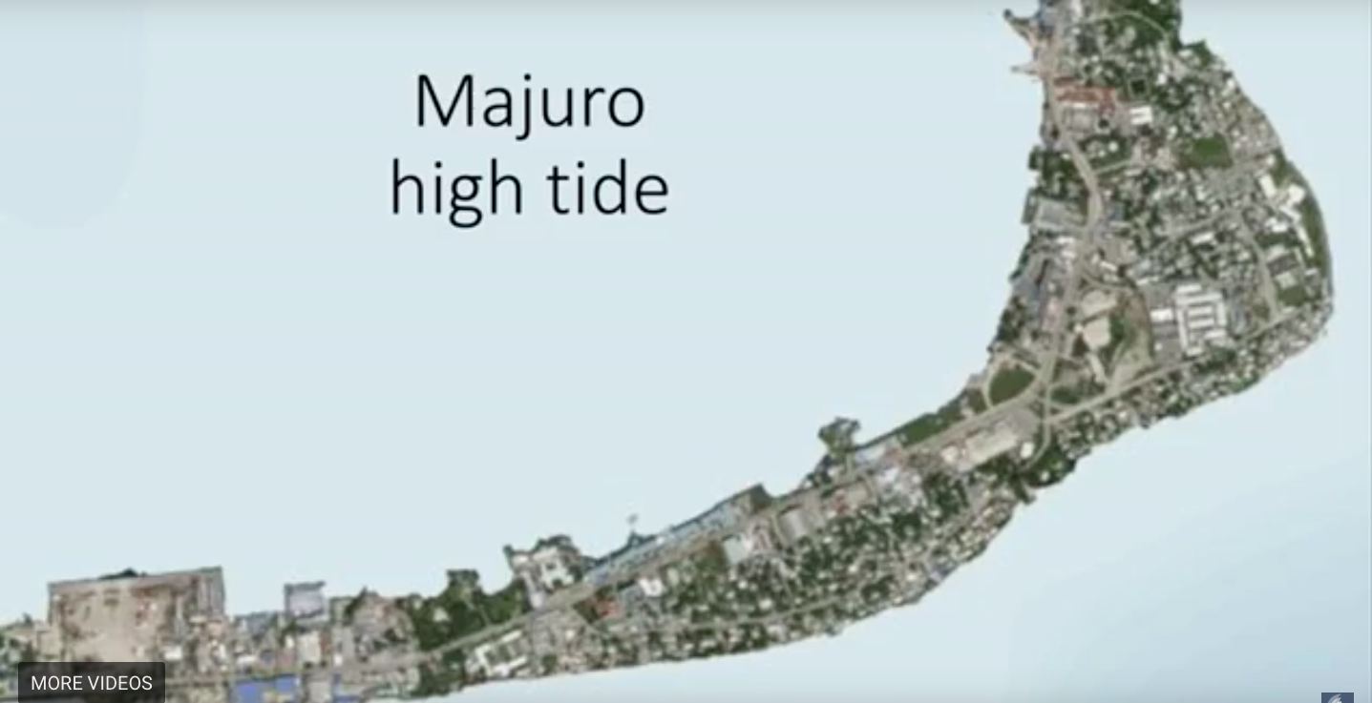
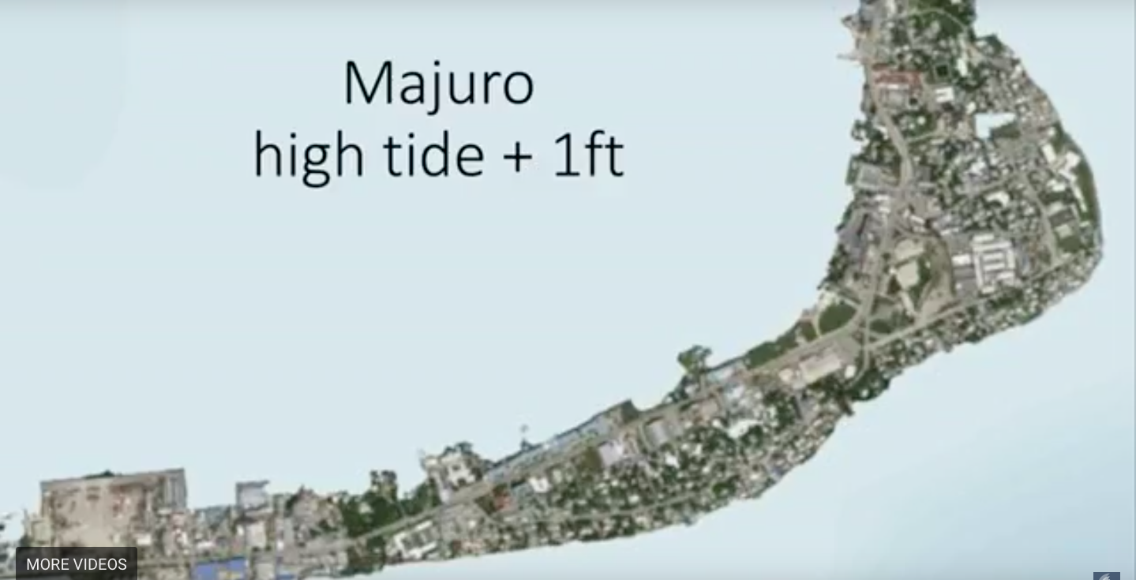

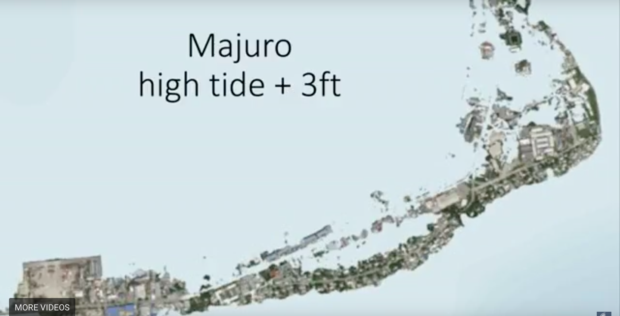

Slide 4
Mr Warri said a group of about 60 people at Londar in south Pentecost was lucky to have survived the cyclone.
"They hid under the church and it flew away. All the other houses had flown so the men stood around in a circle and the women and children stood in the middle.
They stood there until the morning in the rain and the wind."

Slide 5
The MCST Board have asked us to answer 3 questions?
What is THE 1.5 tax for Shipping? = today’s talanoa
What would we have to trade with who to get it?
Who will decide?
Ideally a consensus and ultimately a majority of IMO members states participating in MEPC Plenary and, if necessary, Council.

Slide 7
1. What is THE 1.5 tax for Shipping? = today’s talanoa
ASSUMPTIONS
The level of ambition in the revised Strategy must be increased – ‘not less’ than 100% by 2050’
MBMs are an essential measure in the basket
A tax is the best MBM – it must be just and equitable
Tax [levy]
Polluter Pays
Mandatory and universally applied on all fuel
Awards the most efficient shipping the most
Impacts can’t be avoided, hard to remedy - leaves us mitigation
Revenue generating

Slide 8
1. Why a 1.5 tax on shipping?
Agreed by most commentators
reducing or “levelizing” the additional cost of alternative fuels
incentivizes real GHG emission reduction efforts through technological and/or operational solutions
Alluded to by some commentators
compensation from the polluters to the most affected and most vulnerable
1.5 TAX = Carbon/GHG Pollution tax + R&D subsidy + administration costs
UNFCCC (GCF, GEF, etc) IMO/IMRB ???

Slide 9
When will IMO formally debate MBMs? What will they debate? Who will debate?
What guidance is given to answer these questions?
MBMs are a possible MTM or LTM unless ICS et al proposal is an MBM, in which case MBM negotiations start with STMs.
The Guiding Principles
‘enshrined in instruments already developed’
Non-discrimination
CBDR-RC
NMFT
Polluter
pays
highest possible ambition
Initial Strategy principles
the ‘other’ principles
Precautionary approach
Evidence based
IMPACTS
All Ships

Slide 10
1. What is THE 1.5 tax for Shipping? = today’s talanoa
Tax [levy]
Polluter Pays
Mandatory and universally applied on all fuel
Rewards - the most efficient shipping
Impacts - can’t be avoided, hard to remedy - leaves us mitigation
Revenue generating
1.5 TAX = Carbon/GHG Pollution tax + R&D subsidy + administration costs
UNFCCC (GCF, GEF, etc) IMO/IMRB ???

