Slide 1
SMM Press Conference 8th Sept 2014 World Shipbuilding Dr Professor Martin Stopford Managing Director, Clarkson Research

Slide 2



The Agenda
Shipyards surviving better than expected
Wow, it says I’m going to make $ billions
Shipping Market Trends
World Economy & Ship Demand
Newbuilding Contracts & Future Supply
Shipyard Capacity & Orderbook
Regional Shipbuilding Trends
Energy, Environment & Innovation
“This is turning into a long shipping recession. Meanwhile the increase in fuel costs and regulatory standards presents the biggest technical challenge for fifty years”
Notes:
Developments in the Shipping Cycle & the Impact on Revenues & Asset Values
Martin Stopford 15th September 2009
2

Slide 3

1. Shipping Market & Sea Trade
Recession now in year 6 and still searching for light at the end of the tunnel

Slide 4
Chart 1: Shipping Market Earnings 1993-2014
2008
$50,000/day
Earnings are NOT adjusted for inflation
2004
$39,000/day
2000
$24,000/
day
$27,178/day
$12,145/day
$12,000/day
$8,500/day
(Clarksea Index shows weighted average earnings of tankers, bulkers, containerships & gas.)

Slide 5
Chart 2: Growth of Trade & Cargo Fleet
Shows the “rolling” 7 Year Increase in trade & fleet
World Fleet grows faster than trade
Sea trade steady at 4% growth
Fleet grows slower than trade

Slide 6
Chart 3: “Shadow” Surplus & Laid Up Tonnage
Shows “Shadow” surplus tonnage and the proportion laid up
“Shadow” Surplus – tonnage in excess of the dwt of ships needed to carry trade at full speed
“Shadow” surplus is soaked up by slow steaming today
7a
Updated 8 August 2014
Notes:
Source: laif up tonnage.xls in shadow surplus tab in market/laid up folder.

Slide 7

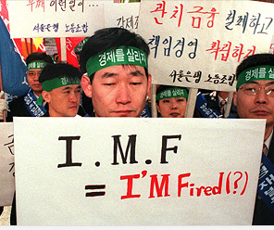

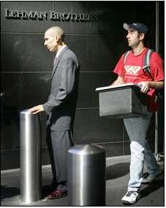
2. World Economy & Ship Demand
Another crisis lurking in the wings?....
Middle East crisis, Lehman Mark 2, China problems???
Collapse of Thai baht sparked Asia Crisis
Dot.com crisis - millionaire for a day
Are these sovereign bonds for the bin, pal?
1997
2001
2011
201?

Slide 8
Chart 4: World GDP & Sea Trade Growth
World GDP (red line) and sea trade (blue line)
% change
Credit Crisis
The sea trade growth
trend is 3.8% pa
Oil Crisis
?
1991
Financial
Crisis
1997
Asia
Crisis
2001
Dot.com
crisis
Crisis 1
1973
1st Oil
Crisis
Crisis 2
1979
2nd Oil
Crisis
Crisis 6
2007
Credit
Crisis

Slide 9
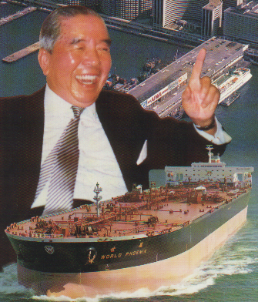




3. Newbuilding Contracts & Major Investors
Shipowners continue ordering despite the recession
I made millions ordering against timecharters
One of those nice shipyards arranged some credit, sir
I should never have ordered those bulkers
I LOVE ordering new ships
I ‘ve really gone off ordering ships
Loan
1960s
1970s & 1980s
1990s
2000's
2010s
2

Slide 10
Chart 5: Shipbuilding Orders 1963-2014
Orders
Orders in 2013 for 169.7m dwt was the 3rd highest ever!
15
Source Maritime Economics 3rd Ed Martin Stopford (Updated August 2012)
Notes:
See data in MEC spreadsheet

Slide 11
Chart 6: Top Ten Shipping Investors First half 2014 by Investor Country of Domicile

Slide 12
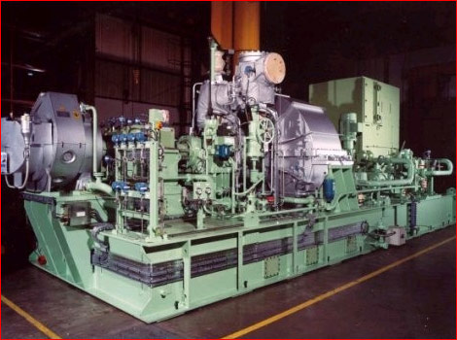
4. Shipyard Capacity & Orderbook
The shipyards are winding down from the biggest boom ever, but sales still active and volatile . Marine equipment sales about $70 bn in 2013, up 30% from $53 bn in 2012
Marine equipment market busy with eco-ships
Notes:
But this growth did not follow a neat exponential pattern.
In fact If we dig a little below the surface shipping investors had to deal with cycles seem to have been operating at three different levels.

Slide 13
Chart 7: The Shipbuilding Cycle
Shipyards adjust capacity downwards after 2000s boom
In 2010 deliveries peaked at 169m dwt
Million Dwt
Forecast
106 m dwt in 2015
Deliveries
Demolition

Slide 14
Chart 8: Number of Active Shipyards
Source: Clarkson Research

Slide 15
Chart 9: Average Yard Output 1998-2013
Average yard produces 50% more than in 2009
Source: Clarkson Research

Slide 16
Chart 10: World Cargo Ship Demolition
Shows the demolition (bars) on left axis & % fleet demolished on right
Million Dwt
% fleet
% cargo fleet scrapped (right axis)
M Dwt demolished in year (left axis)
Notes:
Source: orderbook by month.xls deliveries & OB tab

Slide 17
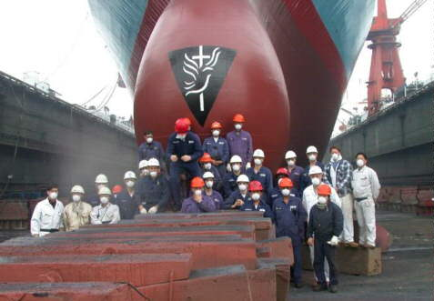
5. Regional Shipbuilding Trends
Position:
China and S Korea “neck & neck” for top position

Slide 18
Chart 11: Regional Shipbuilding Shares 1903-2013
See: page 616
other countries
USA
China
CGT
35.9%
GT
35.4%
Korea
CGT
33.8%
GT
35%
Scandin-
avia
Japan
CGT
18.4%
GT
20.4%
Britain
Europe
Source; Lloyds Register of Shipping, Clarkson Research
GT
1.7%
FIGURE 15.1 Shipbuilding market shares 1902-2013
Notes:
Source: Tables Chapter 15 Fig 15.1, which came from

Slide 19
Chart 12: 2013 Shipyard Output by Country
2013 Output by Country and Ship Type
 | Bulker | Tanker | Container ship | Gas | Offshore | Other | Total
Builder | M.CGT | M.CGT | M.CGT | M.CGT | M.CGT | M.CGT | M.CGT
China P.R. | 7.8 | 1.4 | 1.8 | 0.2 | 0.9 | 1.1 | 13.3
S. Korea | 1.4 | 3.5 | 4.8 | 1.6 | 0.7 | 0.5 | 12.5
Japan | 5.1 | 0.6 | 0.3 | 0.3 | 0.1 | 0.6 | 6.8
Philippines | 0.4 | 0.0 | 0.1 |  |  | 0.0 | 0.6
Norway |  |  |  |  | 0.3 | 0.0 | 0.4
Vietnam | 0.2 |  | 0.0 |  | 0.1 | 0.0 | 0.3
Germany |  |  |  |  | 0.0 | 0.3 | 0.3
Taiwan |  |  | 0.3 |  |  | 0.0 | 0.3
USA |  | 0.0 |  |  | 0.2 |  | 0.2
France |  |  |  |  |  | 0.2 | 0.2
Other | 0.1 | 0.3 | 0.1 | 0.0 | 1.0 | 0.6 | 2.2
Total | 15.1 | 5.8 | 7.3 | 2.1 | 3.2 | 3.5 | 37.0

Slide 20

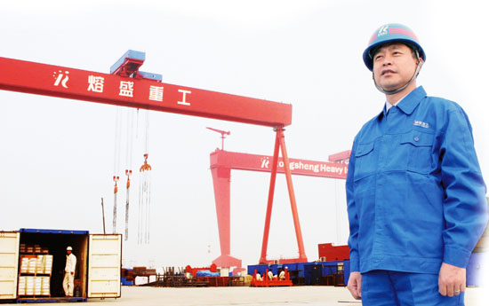



6. Energy, Environment & Innovation
Will owners pay more for an ecoship?
What’s the best way to cut energy costs?
After 30 years of technical stability shipping faces technical challenge
The key issues are:_
Bunker price escalation
Regulations & carbon footprint
2. Shipbuilders
1. Ship owners
3. Escalating Environmental Costs
4. Technical challenge

Slide 21
Chart 13: Fuel Cost Versus Ship Cost
Ship cost: based on cost of new Aframax tanker, including interest, depreciation and OPEX,
Fuel cost: based of 49 tpd for 70,000 tonne cargo at 16 knots
Fuel cost exceeds ship cost
Ship cost exceeds fuel cost
Rough estimate pre 1970
Notes:
C:\Users\Martin\Documents\DATA1\Market Data\Energy\Fuel Economy 2012/cost of ship versus cost of fuel

Slide 22
Chart 14: Fuel Consumption 60,000 dwt Bulkers
Fuel consumption
TPD at 14.5 knots
Oil price in
2013 $s
Bulkers delivered in 2013 no more fuel efficient than in 1986
New Japanese 60k dwt supramax 28 m bpd
New generation ecoships on way
Year of Build
Notes:
Source: Panamax fleet 1970on Sept 2013.xls

Slide 23
Chart 17: Conclusions
It's been a long recession, more like the 1990s in the 1980s. The fleet is still growing too fast to allow trade to soak the surplus, so there is still a way to go.
The shipbuilding market is very active, and orders in 2013 were the 2nd highest ever. Europe is still the biggest shipping investor, with a 44% market share.
The shipyards have cut output by about a third, but deliveries will creep up again over the next 2 years.
China and Korea are vying for the top position and were "neck and neck" in 2013, with 33-35% market shares.
Energy costs are a game changer, but shipping is a conservative industry. The challenge is to embrace 21st-century technology. A little progress has been made but there’s still along way to go.
•Change is vital and the new technology is on show at SMM. So enjoy the exhibition and see how shipping is facing up to the challenge

