Slide 1
Pacific Sail Powered Craft
Successes and failures and lessons learnt
Michael Savins, Kiribati 2012

Slide 2
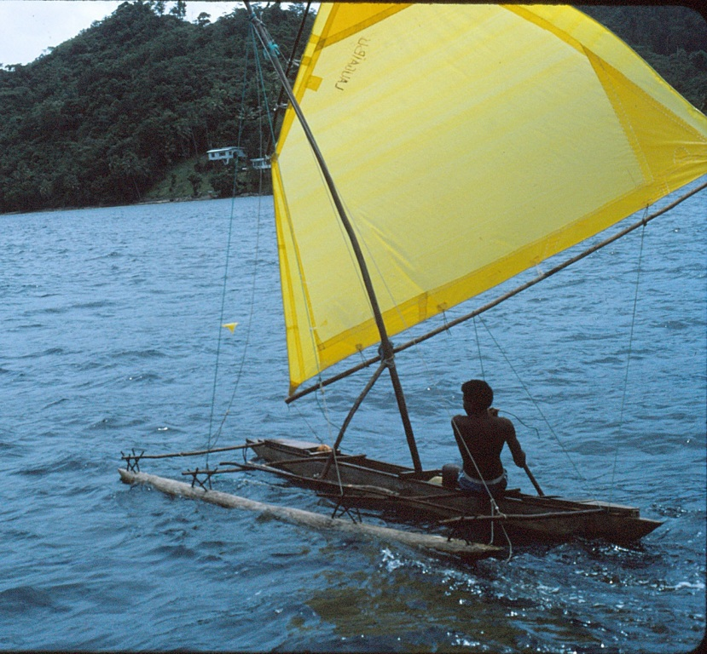
Traditional Sailing Craft
Photo: O Gulbrandsen. PNG

Slide 3
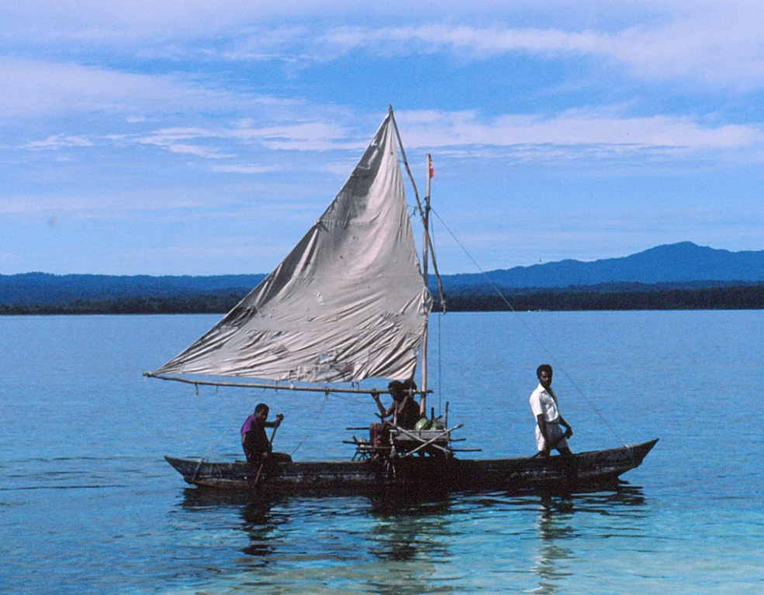
Subsistence fishers and farmers, generally have very limited financial resources. Craft are made of local materials at almost no cost. Paddle or sail is the only affordable propulsion, sail cloth can be made from any low cost material.
Photo: O Gulbrandsen. PNG

Slide 4
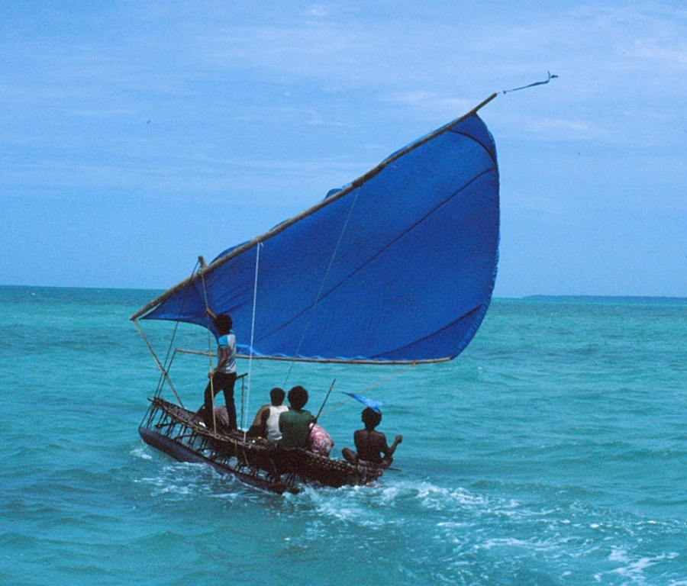
Traditional sailing craft designs, vary dramatically across the vast Pacific region. Variations in traditional designs often due to local wind conditions.
Photo: O Gulbrandsen. Trobriand Islands PNG

Slide 5
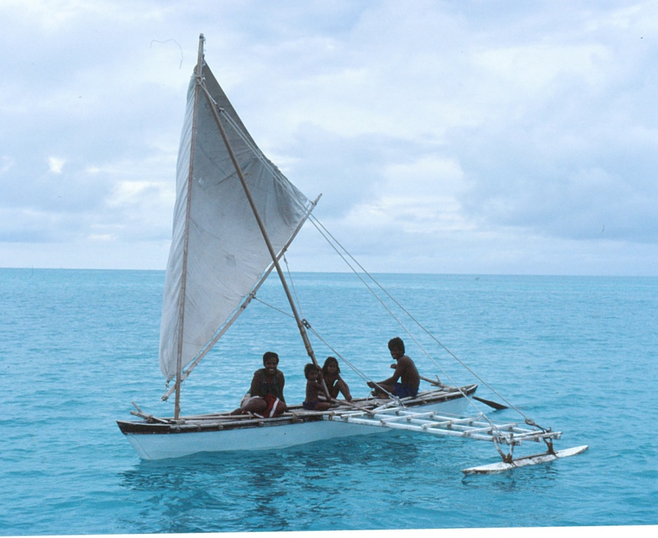
The traditional Kiribati canoe. Construction techniques were developed according to minimal availability of materials
Photo: O Guldrandsen. Kiribati

Slide 6
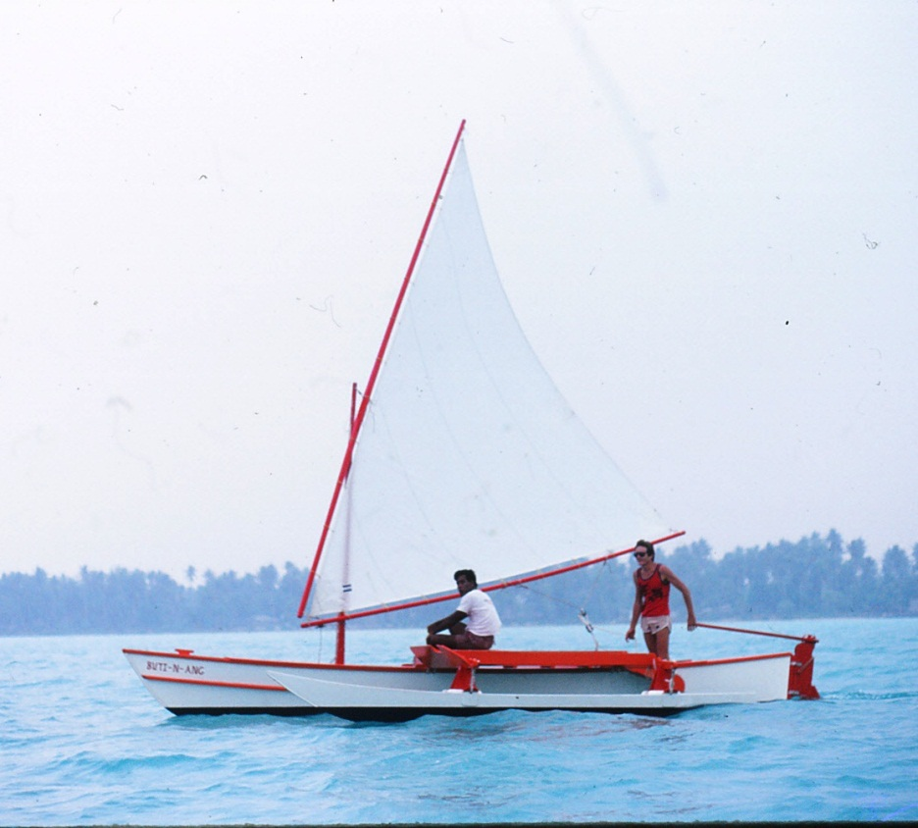
Sailing craft design development 1982-1992
Photo and design: O Gulbrandsen
FAO/UNDP
Artisanal fishing craft development
Kiribati
FAO Regional Fisheries Support Program
The first Kiribati prototype, sailing craft FAO design KIR 2, 7.1 mtr single outrigger canoe. With a 13 sq mtr lateen mainsail.

Slide 7
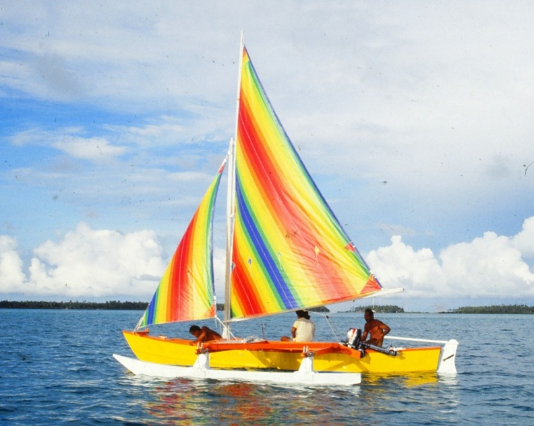
Prototypes/Demonstration/Modifications/ Training/Privatization
KIR 8 design, with gunter mainsail and jib
Photo: O Gulbrandsen. Kiribati

Slide 8
Successes
Approximately 200 FAO improved single outrigger canoe designs built in Kiribati to date. Country wide acceptance and considerable regional interest, more than 20 of the Kiribati designs built in other Pacific Island countries.
Efficient sail rigs, practical and affordable designs. Outer Island canoe workshops (using hand tools) established to meet island requirements.
Within first 2 years, Butaritari Island, several craft and Tabiteuea North sixteen craft built to commercial order. Craft owned and operated by private fishermen. Extensive use of sail, several craft on both islands, secondary outboard motors never used. Reported successful tuna trolling operations under sail.
Private sail makers trained and established, foot treadle sewing machines.
Five private boat builders established.

Slide 9
Challenges
British aid established outer island fish bases and provided outrigger canoes and speed boats to fishermen at 50% subsidised cost. Islands chosen politically and in ignorance of existing developments. But on Tabiteuea North, fishers who were completely self funded with existing fleet of appropriate craft were ignored.
Japanese aid established outer island fish bases and provided outrigger canoes at 100% subsidised price. Large numbers of canoes built under contract within government shipyard. Lack of attention to detail on sail rigs, results in almost all craft de-masted in first weeks of operation.
Attention to detail required to build quality sailing craft is lost in the commercial drive to make profits.
Outboard motor powered craft are simpler to build, as there is considerable less detail in construction. Less complications associated with material purchasing and importation.

Slide 10
Other Scenario Kiribati
In 1985 a sailing catamaran was built in Majuro, Marshall Islands. An American boatbuilder with funding from Save the Children builds and deliver’s to the Abaiang Island Council, a J.Brown-designed 14 mtr sailing catamaran.
Abaiang Island council operated this as a passenger/cargo vessel between Abaiang and Tarawa Islands for about five years. The sails deteriorated and hulls developed dry rot. The craft remained on a beach for about five years. Then was restored by the Abaiang Island council. There was no attempt to refit any sails, as two 40hp outboard motors were fitted. Fuel consumption was excessive, as fuel costs far outweighed income. The operation then stoped.

Slide 11
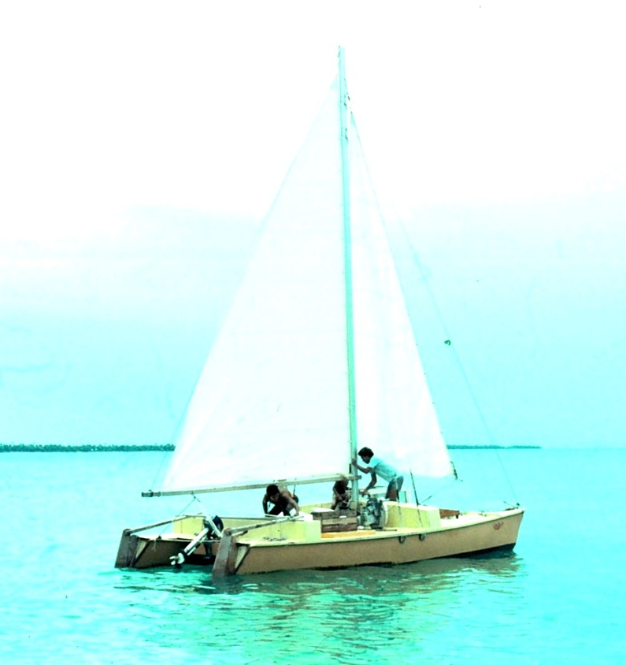
Other Scenario Tuvalu
Save the Children
Implement a boat building project in Funafuti.
Jim Brown and his son, train boatbuilders in constant camber construction techniques and build several 7.3 mtr sailing catamarans .
Several smaller paddling sailing canoes are built with compounded plywood technique.
The boatyard continues commercially under Tuvalu management.

Slide 12
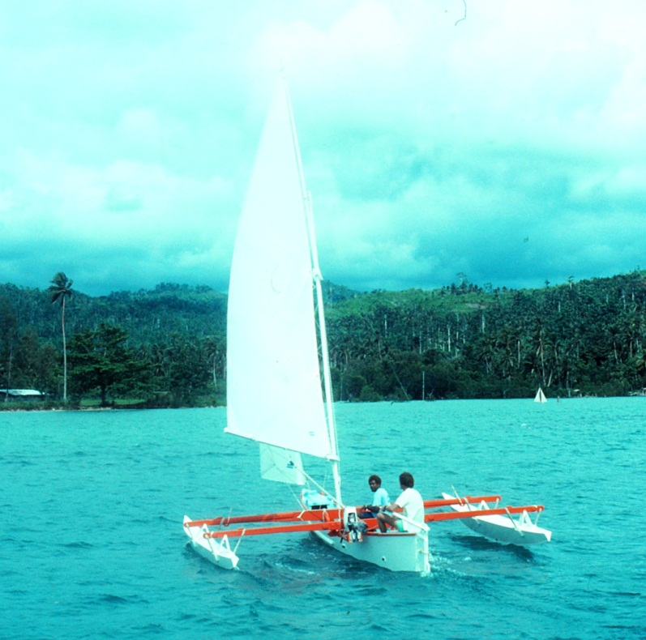
Other Scenario: Solomon Islands
1984 FAO/UNDP Develop an artisanal boat building development project in Auki.
Two prototypes built.
Sailing trimarans to provide a safe and stable platform for inexperienced sailors.
1988 another two trimarans built in Gizo. Craft are demonstrated throughout Western Province. Fuel prices in remote locations double the price of fuel in the capital.
Photo: O Gulbrandsen

Slide 13
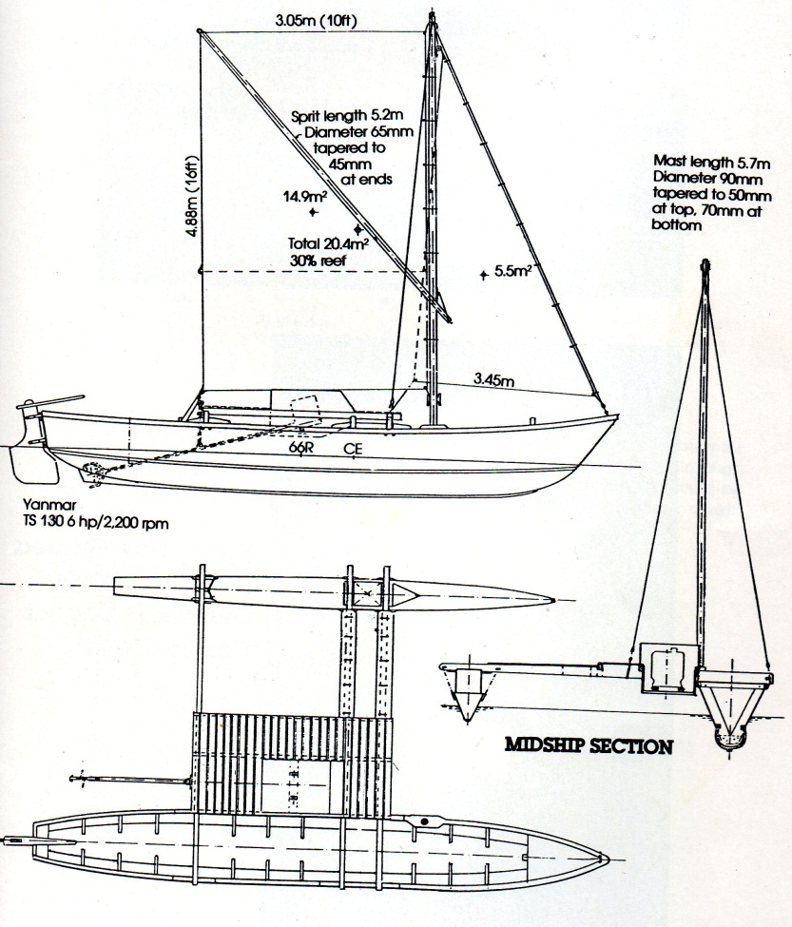
Other Scenario Papua New Guinea
Papua New Guinea Fisheries Department with technical assistance FAO/UNDP develop several artisanal boat building development projects. Port Moresby, Oro Bay and Manus Island.
Extensive development of appropriate low cost, sail and engine powered improved commercial fishing craft.

Slide 14
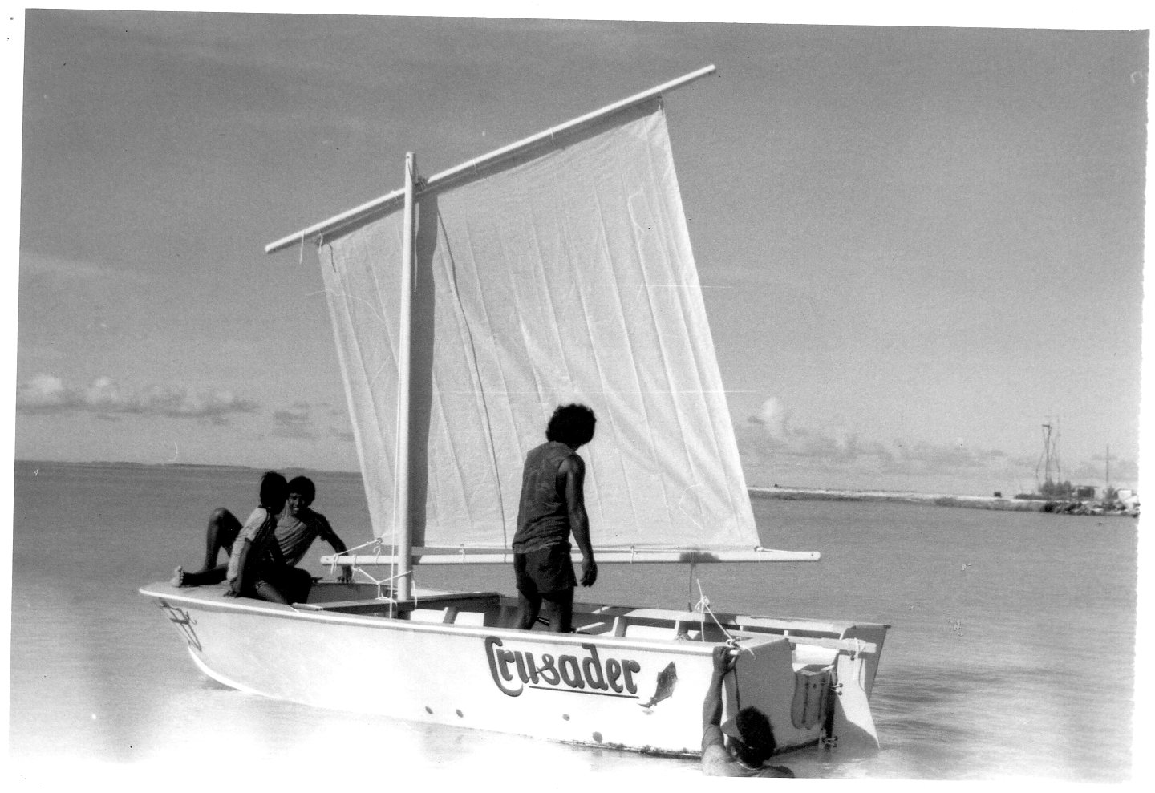
Sail for safety
Artisanal fishermen utilizing one engine, daily place their lives in jeopardy. Emergency sail should be mandatory throughout the Pacific.

Slide 15
Conclusions
All examples I have provided consist of development work with appropriate craft and sail power. However, the only place where the sail introduction continues today is at locations there is a living tradition of the use of sail on traditional craft.
The FAO/UNDP project in Kiribati provided complete packaged craft to fishermen in 1985 for approx. AUD$2,000. Today the same craft is AUD$9,000.
The dramatic increase in price reflects the state of doing business in a Pacific Island country. Formidable vast geographic locations, limited natural resources and products to trade. Emerging capitalism within the modernity of community structures.
Margins placed on imported materials are so excessive, modern craft are unaffordable. Limited competition within the business sector maintains high price factors.

Slide 16
Recommendations
Aid/development projects such as the Artisanal Fishing Craft Development Project in Kiribati promoted appropriate technology and vessel designs and was able to provide an affordable entry point for the average I-Kiribati fishermen.
Appropriate technology can consist of new and emerging concepts. Concepts need to be proven. Demonstration of benefits over time, and adaptation to local conditions and cultural preferences are so important to achieving long-term sustainability in the Pacific Islands
Remote disadvantaged communities of the Pacific have extremely limited options to move out of poverty. Climate change is and will continue to have a serious effect on all of the Pacific. The vast islands of the Pacific rely on sea transportation for basic livelihoods. The region is in dire need of initiatives to develop sustainable craft for the future.

