Slide 1
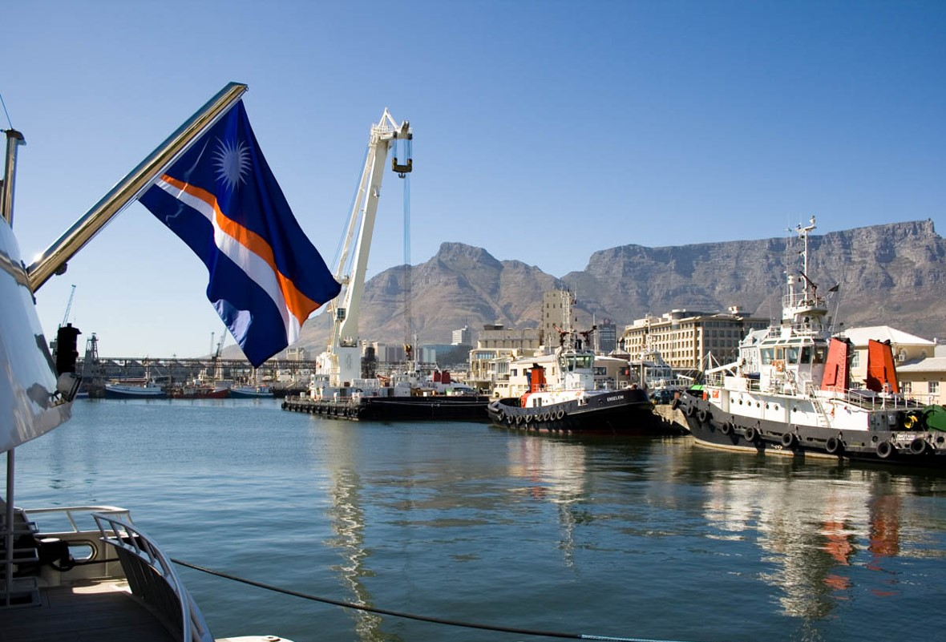
RMI Ship and Corporate Registries Assessment and Options Technical Assistance Project
28 May 2021

Slide 2
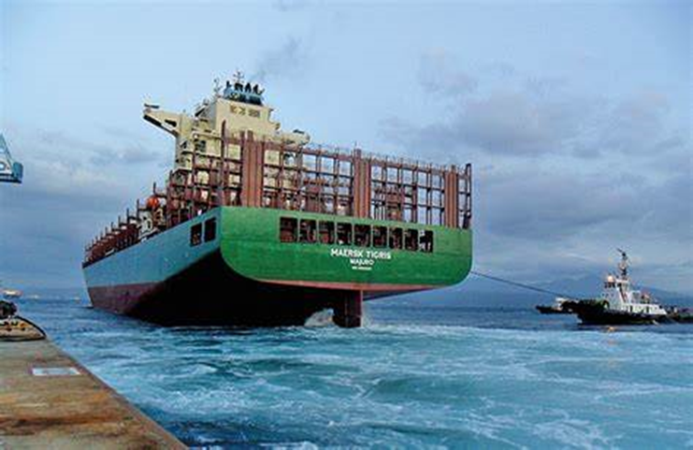
RMI Registries
If RMI could re-contract now, what should be changed or included in the contract? – a “wish list”
Then consider how the “wish list” could be achieved – time line strategy

Slide 3
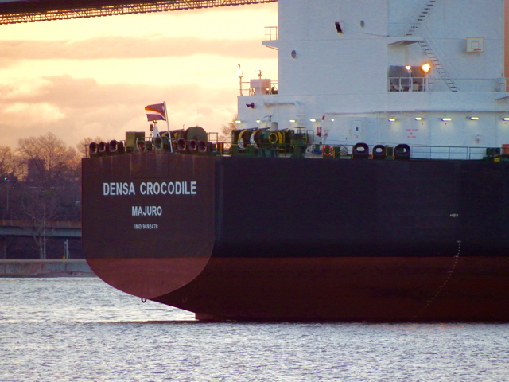
Marshall Islands | Guide to Ship Registries
https://www.guidetoshipregistries.com/shipregistries-country/marshall-islands

Slide 4
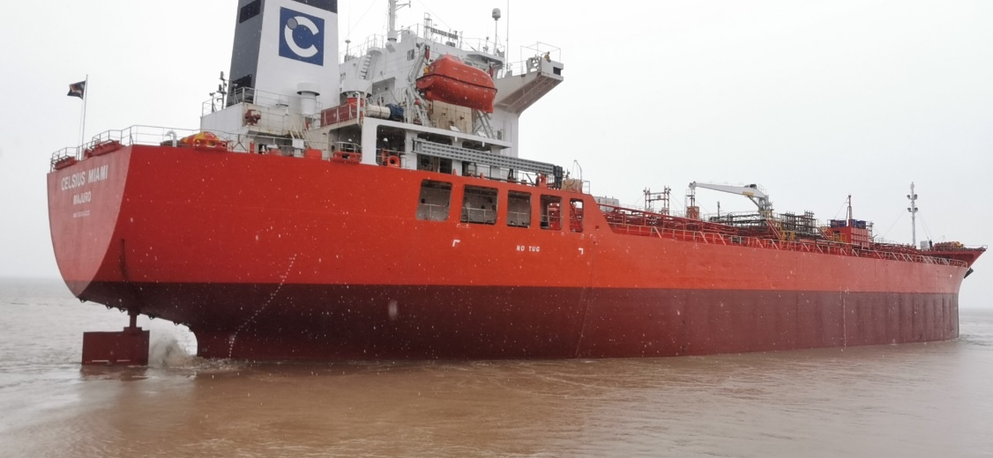
Task
List those things that you would want to see in a “new contract” – the wish list.
E.g. 1 Financial transparency

Slide 5
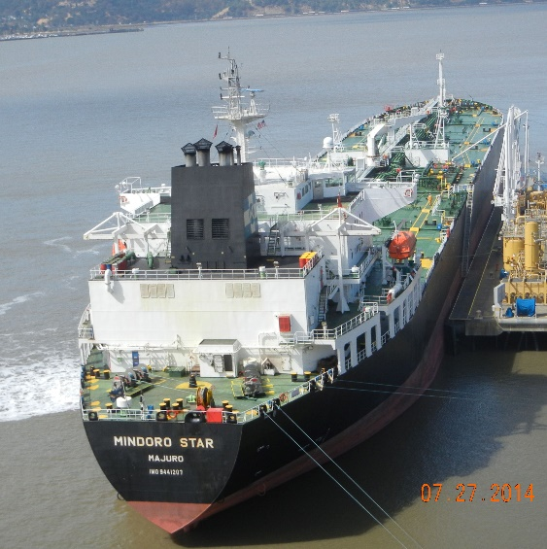
Wish List
Financial transparency
Financial equity
Access to RMI Shipping and Corporate Registry
Transparency of RMI Shipping and Corporate Registry
IMO and ILO participation
Capacity Building
Oversight on international obligations

Slide 6
1. Financial transparency
Requirement in the 1990 Amendment | Current Status
The Administrators (MIMA and TCMI) must provide the RMI Government with an annual budget for the maritime & corporate programs. The budget must show “anticipated revenues and expenses,” including “operating expenses, reimbursement of loans, payments and advances and other expenditures made by Administrators and its subsidiaries and affiliates,” for the next calendar. | Deleted
The Administrators must provide the RMI Government with quarterly variance reports. The reports must show “actual income and expenses versus budgeted income and expenses” for the maritime and corporate programs. | Deleted

Slide 7
Requirement in the 1990 Amendment | Current Status
TCMI must provide the RMI Government with copies of any “audit reports” prepared in relation to its balance sheet. The RMI Auditor General, or a certified public accountant contracted by the Auditor General, may “audit the financial and operational affairs of [TCMI] or any of its subsidiaries and affiliates associated with the maritime and corporate programs to the extent they are involved in the program.” | Retained with amendments.
The Trust Company and its affiliates and subsidiaries shall perform all of their duties under this agreement at cost. For purposes of this agreement the term costs shall mean actual costs incurred without provision for additional on costs, or markup of any kind or type whatsoever. On costs shall means markups between subsidiaries and affiliates. | Deleted
TCMI must inform the RMI Government of international maritime conferences and meetings. | Retained.

Slide 8
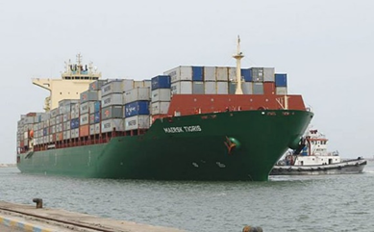
1. Financial transparency
Contract- Re-instate deleted provisions or new improved provisions
(eg on cost of affiliates and not only TCMI)
Legislative amendments (to both Maritime Administration Act and Corporations Law) to follow contract

Slide 9
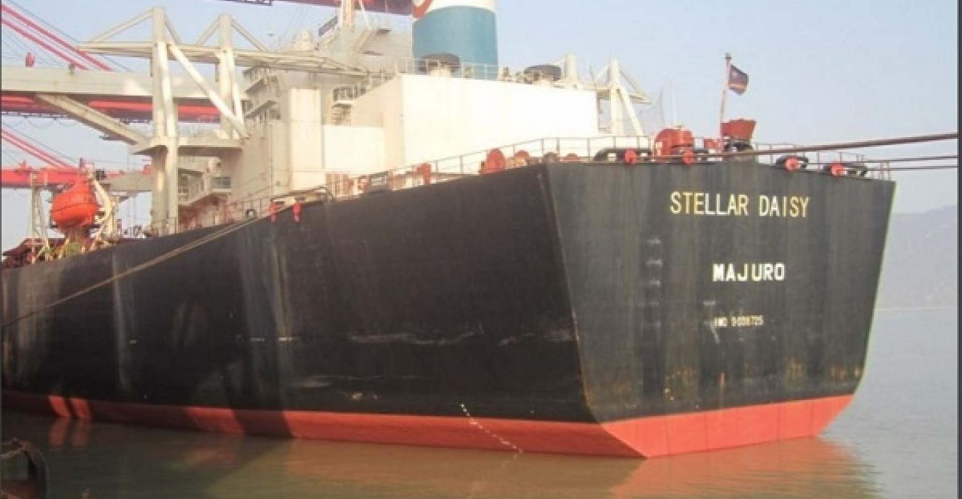
2. Financial equality
Fair return – does that mean an increased flat fee or a % of net or gross earnings (and associated risk of loss)?
Really only determine what is fair once the actual financial position of IRI/MIMA/TCMI is.

Slide 10
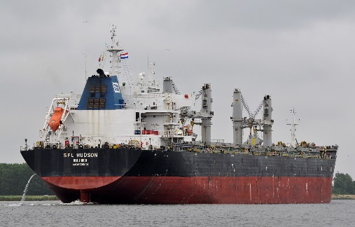
3. Access to RMI Shipping and Corporate Registry
Currently TCMI owns “all records, programs, files, systems, procedures and documents of the Registry”
Options include:
JV – shared ownership
    Allows TCMI to retain Registry but provide RMI access
    Require Registries to be based in RMI and access when needed (ie Attorney-General and Auditor- General Processes?)
Legislative Amendments to follow contract (eg s.107 Maritime Administration Act)

Slide 11
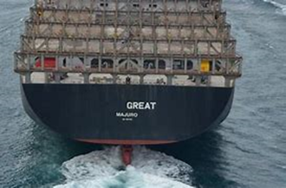
4. Transparency of RMI Shipping and Corporate Registry
Following 3 – legislative amendments including subordinate legislation held by TCMI to increase Registry transparency
Cost: Likely decrease in registered numbers

Slide 12
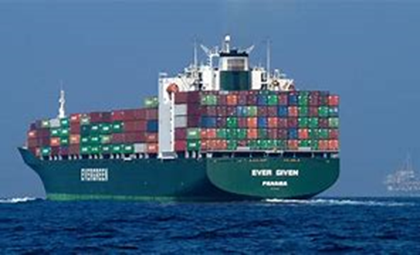
5. IMO and ILO participation
Existing contract may not need amendment, but could be improved by providing for:
RMI head of delegation
RMI overview and agreement of TCMI representatives
Obligation to cooperate and share information
Clear statement that IMO/ILO representation is for benefit of RMI (shipowners etc benefit mutually with, and not in opposition to that of RMI – eg green shipping)
Costs for RMI and TCMI delegations to be covered through MIIP fee

Slide 13
6. Capacity Building
Maritime Administration Act §201(1) ‘Statement of policy’
This Title is intended, and shall be construed, to encourage and foster the growth and development of the foreign and domestic commerce; to promote and protect the national defense and security of the Republic of the Marshall Islands…; to preserve and protect the marine environment; and to regulate a uniform national program of marine safety, inspection and documentation.

Slide 14

6. Capacity Building
1990 JV - The Trust Company shall assume the obligations of the existing joint venture for the Marshall Islands Maritime Training Program
Extension or specific obligations
Extension of Min T&C and TCMI cooperation?

Slide 15
7. Oversight on international obligations
1990 JV Trust company to liaise with RMI appointment
To meet annually and provide reports on the maritime and corporate programs and financial information provided to RMI under contract
Expanded oversight but reduced Registry rights and obligations, especially:
eg remove “sole right” of administrator to promulgate regulations and other acts, and where promulgated, requiring RMI approval (eg Minister of T&C or appointee)
eg increased judicial function for all fines, penalties etc
Require legislative amendment following contract

Slide 16

Scope of negotiations
1995 “ … the parties to the JV agreement now wish to further amend that agreement in certain respects”…
2015 “ … new schedule will be negotiated in the same spirit of good faith and cooperation that has led to the successful and continued growth of the programs”.
RMI exhibited good faith in considering amendments to the 1990 JV on 7 occasions, and on matters other than financial split (eg reporting requirements)
Artificial to separate financial aspects of the JV agreement with all other rights and obligations, and as such, ought to eb subject to negotiations in good faith

Slide 17
Time-line strategy
Auditor general/PAC
Information gathering
Arbitration
Scope may be uncertain
NEGOTIATION: Current but scope uncertain
ie. Financial settlement
or broader considerations – but difficult to disentangle (ie associated with financial settlement are other considerations)
REQUIRES GOOD FAITH NEGOTIATIONS

Slide 18
Time-line strategy – “pressure points”
?
NEGOTIATIONS
ARBITRATION –NEW YORK
Auditor general/PAC
IMO Head of delegation
Aug 2021
Legislative amendments of non-interfering provisions
Aug/sept 2021

Slide 19
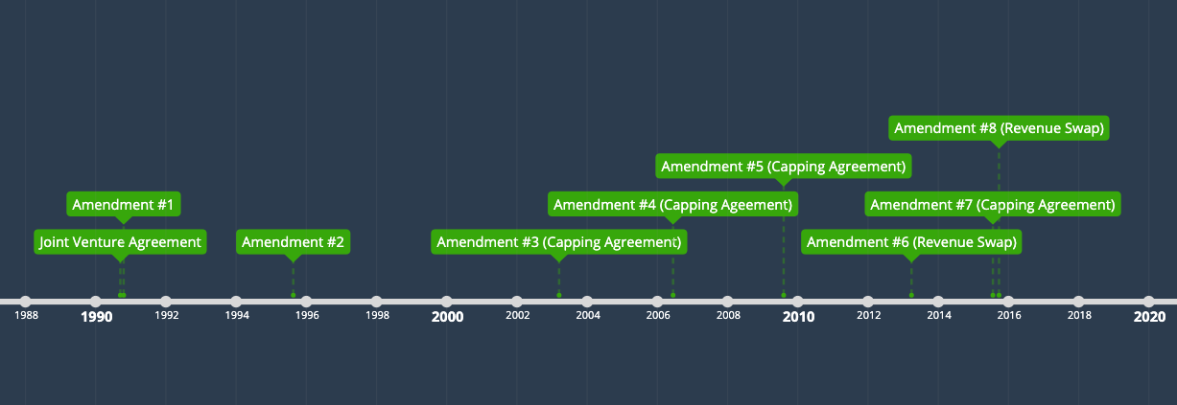
Contractual History

Slide 20
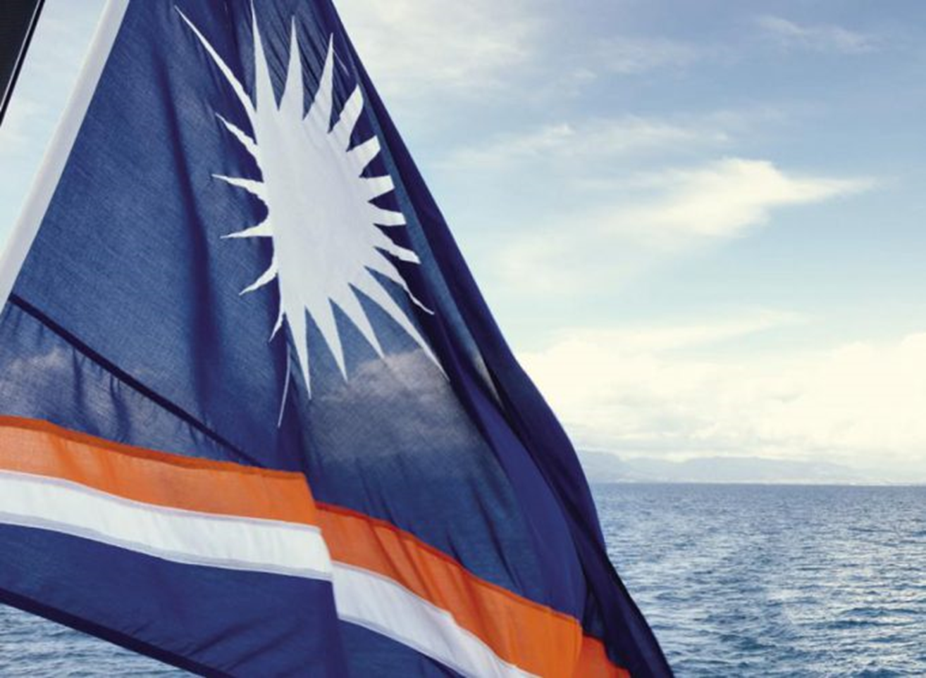
Please feel free to contact me regarding information presented in the workshops c.forrest@law.uq.edu.au

