Slide 1


Sustainable Shipping:
Anchored or adrift in the Pacific’s emission targets?
Photo courtesy: Derick
PACE-SD Seminar Series | Thursday 19 May 2016
Avnita Goundar
PhD Candidate, Sustainable Sea Transport Research Programme
Pacific Centre for Environment and Sustainable Development
The University of the South Pacific, Suva, Fiji

Slide 2
Pacific’s commitment to reducing greenhouse emissions
The contribution of PICs to global greenhouse emissions is negligible, accounting for ~0.03% of the global emissions of CO₂ from fuel combustion.
Against this background and the fact that they are all Small Island Developing States, PICs were not compelled to set ambitious emission reduction targets under the Paris Agreement but they have done so.
Demonstrates solid commitment of a region that is already experiencing the devastating effects of climate change, and facing the threat of loss of cultures and countries.

Slide 3
INDC commitments of Pacific countries

Slide 4
Sectors targeted by Pacific countries in INDCs
Palau
Tuvalu
Marshall Is
Tonga
Vanuatu
Cook Is
Fiji
Nauru
Niue
PNG
Samoa
FSM
Kiribati
Solomon Is

Slide 5
Key issues in PIC INDCs
Difficult to compare as they are not measured in the same way:
  Different baseline years for GHG emissions (ranging from 2000 to 2010 to no data).
  Different sectors covered (electricity, electricity/transport, all sectors)
  Different target years (from 2020, 2025 to 2030) and some PICs chose to keep targets for two different years.
  Conditional and unconditional commitments vary
Major data gaps are obvious in almost all PIC INDCs:
  Sectoral and sub-sectoral GHG emissions data for missing in some
  External funding required to fulfil conditional pledges missing in some
  reliability of data highly questionable in some cases.

Slide 6
As of 11 February 2016, 161 countries, including 14 Pacific Islands countries, have submitted their Intended Nationally Determined Contributions (INDCs) to UNFCCC.
Where
does shipping fall in the Pacific’s emission targets?

Slide 7
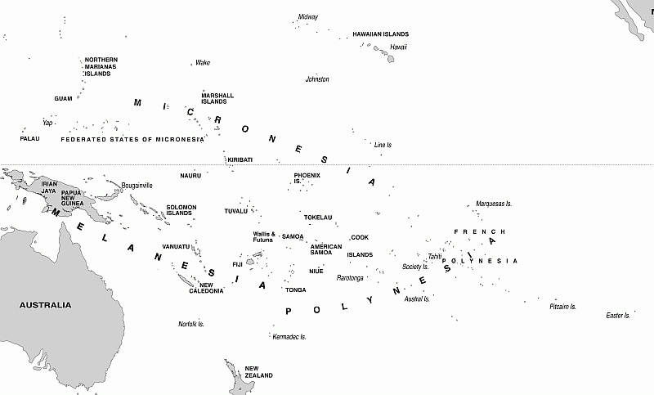
Sea transport features in the INDC targets for one PIC
RMI estimates that in order to achieve its overall INDC target for 2030, emissions from its transport sector (including land and shipping emissions) have to decrease by 16% in 2025 and by 27% in 2030.

Slide 8
The domestic shipping sector’s contribution to GHG emissions is known for two PICs only
10%
1%

Slide 9
Transport sector features in the INDC target sectors of eight PICs
Only PIC to set a target for transport sector - 16% in 2025 and by 27% in 2030.

Slide 10
Country | Inclusion of transport sector in INDCs
 | Inclusion in INDC target | % reduction by 2025 | % reduction by 2030
Cook Is | no | n/a | n/a
FSM | yes | no data | n/a
Fiji | no | n/a | n/a
Kiribati | yes | no data | no data
Nauru | no | n/a | n/a
Niue | no | n/a | n/a
Palau | yes | no data | no data
PNG | no | n/a | n/a
RMI | yes | 16% | 27%
Samoa | no | n/a | n/a
Solomon Is | yes | no data | no data
Tonga | yes | no data | no data
Tuvalu | yes | no data | no data
Vanuatu | yes | no data | no data

Slide 11
The energy sector is the largest emitter of GHG. In 6 out of 14 PICs, the transport sector is a larger emitter than electricity

Slide 12
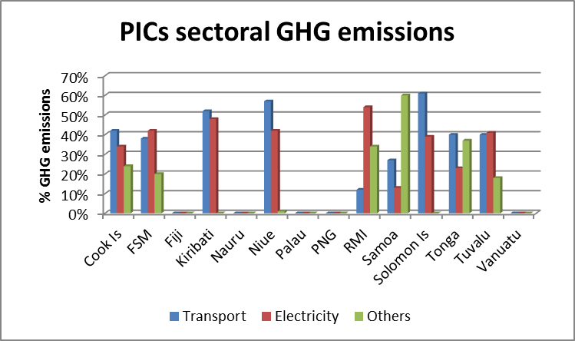
Comparative sectoral GHG emissions of PICs (compiled from PICs INDC reports, 2015). No bars indicate no data in INDC report.

Slide 13
Country | Contribution of transport emissions
 | Overall (%) | Sub-sector emissions
 |  | Land | Air | Sea
Cook Is | 42% | 33% | 8% | 1%
FSM | 38% | 28% | no data | 10%
Fiji | no data | no data | no data | no data
Kiribati | 52% | no data | no data | no data
Nauru | no data | no data | no data | no data
Niue | 57% | no data | no data | no data
Palau | no data | no data | no data | no data
PNG | no data | no data | no data | no data
RMI | 12% | no data | no data | no data
Samoa | no data | 27% | no data | no data
Solomon Is | 61% | no data | no data | no data
Tonga | 40% | 40% | no data | no data
Tuvalu | 40% | no data | no data | no data
Vanuatu | no data | no data | no data | no data

Slide 14
Reflections
Low carbon shipping continues to be viewed as a ‘high hanging fruit’ and is still not a priority in regional and national development agendas when compared to electricity generation.
PIC INDCs, as currently presented, are not adequately powered to drive transition to low carbon shipping in the Pacific region.
Urgent need for development of more robust data collection methods and data analysis for determining appropriate sectoral emission reduction targets in INDCs.
Further research required to assess level of investments and current efforts in strengthening/improving transport data collection and repositories at national and regional levels.

Slide 15
Reflections
Revision of initial INDCs
  Absence of relevant information in initial preparation disadvantaged developing countries
  Can be revised if conditions change and more information is available on actual needs and resources required.
  INDCs will become Nationally Determined Contributions (NDCs) once a country ratifies the Paris Agreement .
  Timeframe for next revision can be between December 2015 (after COP21) and 2020 – however, countries have the option of implementing their current INDCs as NDCs from 2020 and then revise to submit a new NDC in 2025.

Slide 16

Thank you!
Photo courtesy: www.muavoyage.com

